Slide 1
Teens use digital arts to help seniors share lessons they’ve learned from their life experiences.
UntangleTheWeb.com
The external links in this presentation open in a web browser. Please allow your browser and this presentation to be viewed in their own, separate windows side-by-side on your desktop.
Elevator Pitch:
Advance to next slide for more detailed overview of project.

Slide 2
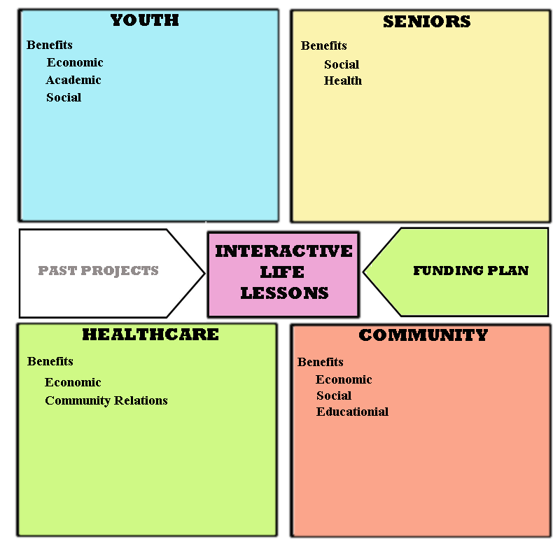
Tech Arts Training Program
Digital Journalism Course
The external links in
this presentation
open in a web
browser. Please allow
your browser and this
presentation to be
viewed in their own
separate windows side-by-side on your desktop.
go to Youth
go to Seniors
Graphical Menu ➔
(click on areas to navigate)
go to Past Projects
go to Funding Plan
go to Life Lessons
go to Healthcare
go to Community
Back to Elevator Pitch

Slide 3
Interactive Life Lessons
Teens use digital arts to help seniors share lessons they’ve learned from their life experiences.
In this intergenerational, technology/arts project, at-risk teens and out of school youth create interactive portraits of local seniors who share lessons they have learned from their life experiences. The course is scheduled to begin in Wakulla County in September of 2015.
Current Community Support
Example questions students ask of senior partners:
Can you tell me about an experience you’ve had that taught you something about life? (Main narrative element)
Examples of Senior Life Lessons
Other Questions
-What things would you do differently as a teen, knowing what you know now?
-What is the best way to live? (What’s ‘the good life’ to you?)
-What areas of your life do you feel good about?
Deliverables | Needs
Back to Elevator Pitch

Slide 4
Youth
Through an innovative, art-centered approach, we are able to engage young people who might otherwise remain disenfranchised. Graduates of our Digital Journalism Course obtain certification in marketable technology skills, develop their creative capabilities, learn discipline and teamwork, and integrate important life lessons.
Economic Benefits
The TechArts Digital Journalism Course is designed to take teens with limited computer skills and move them toward technological self sufficiency and then on to further education and fulfilling careers. We focus on providing training in occupational areas of high local need.
CareerSource has identified 60+ at-risk and out of school youth, between the ages 16 – 24, from Wakulla County for our program. Each student will be required to interview for a position in our media production crew. They will be trained in all areas of production but, during the first half of the semester, they will work only in the role for which they were selected. These crews will produce the senior’s interactive life lessons.
During the last half of the semester, students will begin production on their own interactive life lesson. In this project they will serve as a ‘crew of one’ managing all aspects of production (pre and post production, audio, visual and interactivity) and will have complete creative control over the final product.
Production work will be tightly scheduled so that all senior and student life lessons are completed by the last week of the semester. Each Multimedia final product will indicate crew member roles and credit each student.
Production Course Work | Occupations/ Skills Learned | Certifications
Academic Benefits
Curricular support for English, history, social studies and life skills classes.
Research has shown that arts programs improve school performance and accelerate learning in academic areas.
Social Benefits
Helps teens
Adopt a long range view ( Bill’s timeline | Tony’s timeline ) ⬅content from older tech arts project
Take inventory of own priorities and relationships
Reflect on issues related to character (examples of students’ writing) ⬅content from older tech arts project
Build confidence (Publishing own content to world, Member of a media crew)
Back to Elevator Pitch

Slide 5
Seniors
This oral history project uses the digital arts to bridge the generational divide and bring the moderating voices of our seniors into the daily discourse. Seniors participate by reviewing their lives and identifying important milestones in their personal timelines and sharing one experience that taught them something about life. This self-narrative activity can involve writing, drawing, an audio recorded interview or all three approaches.
Social Benefits
Digital technologies now drive social interactions and this leaves many of our seniors out of the conversation. (Meanwhile, our youth are inundated with streams of information, mostly void of meaningful content.) This project uses the digital arts to showcase the wisdom of our seniors and give them the opportunity to contribute to the cultural dialogue.
Health Benefits
Physical Health improved by Self-Narrative Activity
The scientific research on the benefits of so-called expressive writing is surprisingly vast. Studies have shown that writing about oneself and personal experiences can improve mood disorders, help reduce symptoms among cancer patients, improve a person’s health after a heart attack, reduce doctor visits and even boost memory. Now researchers are studying whether the power of writing — and then rewriting — your personal story can lead to behavioral changes and improve happiness. The concept is based on the idea that we all have a personal narrative that shapes our view of the world and ourselves…Some researchers believe that by writing and then editing our own stories, we can change our perceptions of ourselves and identify obstacles that stand in the way of better health.
http://well.blogs.nytimes.com/2015/01/19/writing-your-way-to-happiness/
Making Art Tied to Fewer Cognitive Problems in Old Age
http://www.psmag.com/health-and-behavior/making-art-tied-to-fewer-cognitive-problems-in-old-age
Examples of Seniors’ Life Lessons
“If we could sell our experiences for what they cost us, we’d all be millionaires.”
— Abigail Van Buren
Back to Elevator Pitch

Slide 6
Community
Our community will have access to a database of life lessons shared by our local seniors. Wakulla County has undergone tremendous change within this current generation: weather disasters, extreme poverty of the 1900s, racial strife, establishment of Wakulla Springs, tourism booms, nationally acclaimed water shows and Hollywood movie productions, surging residential growth, a shift away from a fishing economy and an historic oil spill. These public events intersect with and inform our seniors’ personal timelines and provide a wealth of valuable life experience we all can learn from.
Economic Benefits
Our entire community benefits when youth gain the skills necessary to compete and succeed in our Internet-connected economy.
We focus on providing training in occupational areas of high local need like Software and Application Development.
Social and Educational Benefits
Every community is made richer when all members contribute to the cultural dialogue. The TechArts Digital Journalism course celebrates the voices of those who are often left out of the conversation: Low income, disenfranchised youth and our senior citizens.
Future Plan
In 2 years we expect to have over 200 multimedia life lessons in our database, a fully interactive website and enough traffic to begin a substantive community dialogue about the best ways to live and what a good life is.
By then we will have refined our workflow and template system to the point where we can engage groups of residents (at nursing homes, rehab facilities and senior centers) in 1 day lesson-creating workshops.
Back to Elevator Pitch

Slide 7
Healthcare Community
Nearly one-half of the nation’s healthcare institutions provide arts programming for patients, families, and even staff. 78 percent deliver these programs because of their healing benefits to patients—shorter hospital stays, better pain management, and less medication.
Economic Benefits (Shorter Hospital Stays, Fewer Complications, Improved Community Relations)
Self Narrative Activity Can Make Physical Wounds Heal Faster
In 2013, New Zealand researchers monitored the recovery of wounds from medically necessary biopsies on 49 healthy adults. The adults wrote about their thoughts and feelings for just 20 minutes, three days in a row, two weeks before the biopsy. Eleven days later, 76% of the group that wrote had fully healed. Fifty-eight percent of the control group had not recovered. The study concluded that writing about distressing events helped participants make sense of the events and reduce distress.
http://mic.com/articles/98348/science-shows-writers-have-a-serious-advantage-over-the-rest-of-us
Arts Activities improves Patients’ QOL Measures
Participation in a new Arts-in-Medicine Program correlated with improved Quality of Life measures, and there were encouraging trends for depression, as well as certain laboratory and hemodialysis parameters
http://www.ncbi.nlm.nih.gov/pubmed/16490625
Back to Elevator Pitch

Slide 8
Funding Plan
Deliverables | Budgets | Needs
Grants
Big Bend Homeless Coalition: Program Development Plan
  Alzheimer's Project
  Awesome Foundation
  Gannett
  Leon Schools Foundation
  Florida Council for Humanities
  National Endowment for the Humanities (Digital Humanities)
  William T. Grant Foundation
  Adobe
  Council on Culture & Arts
  Sustainable Arts Foundation
  Knight Foundation (Community Foundation of North Florida)
  Adobe Foundation (Adobe Youth Voices)
  Walmart Foundation
  The Foundation For Leon County Schools
  President’s Committee on the Arts and the Humanities
Income
Media Services: Interactive life lessons posted on corporate web site, DVD and for kiosk display in lobby.
  Nursing Homes
  Rehabilitation Centers
  Hospitals
  Independent Living Facilities
Merchandise
  Original Artwork: paintings, drawings
  coloring books/pages of seniors’ life lessons for younger relatives/ friends
  comic books books/strips of seniors’ life lessons for younger relatives/ friends
  Donations
  Wakulla County Historical Society (501(c)(3) accepts donations through project website (PayPal donation button on database search page.) Donors can opt for a subscription. (One multimedia life lesson delivered to inbox each week or can download a screen saver slideshow.)
  Sponsorships
  Ads on project web site/ search engine and database.
Back to Elevator Pitch

Slide 9
Current Community Support
Sponsors: Wakulla County Historical Society
Supporters:
University of Florida Shands Arts in Medicine ⬅ Pilot Project
Capital City Bank (funds)
Big Bend Homeless Coalition (in-kind, program development)
Wakulla County Public Library (in-kind)
CareerSource of Wakulla (?)
Collaborators:
Quip, David Stiller
FSU Art Dept , Prof. Keith Roberson
Back to Elevator Pitch

Slide 10
Deliverables
Saturday Only Program (18 week, 5 students) downscaled version
679 program hours including 126 hours of Instruction
  DJ Production Course: 5 students, 2015-16 school year
8 multimedia life lessons
  5 student, 3 senior, posted to Web
  Cross platform/ OS (mobile, desktop, kiosk, Xbox,, etc.)
One kiosk presentation and art show
  At community center or care facility
Web site and database
  Public can browse creatively produced multimedia life lessons
Academic curriculum
  Using life lessons in English, History, Social Studies, Life Skills
Production Course Curriculum (replicable model, some consultation)
Fill Year Program (36 week, 30 students)
1740 program hours including 1440 hours of Instruction
  DJ Production Course: 30 students, 2015-16 school year
44 multimedia life lessons
  30 student, 14 senior, posted to Web
  Cross platform/ OS (mobile, desktop, kiosk, Xbox,, etc.)
One kiosk presentation and art show
  At community center or care facility
Web site and database
  Public can browse creatively produced multimedia life lessons
Academic curriculum
  Using life lessons in English, History, Social Studies, Life Skills
Production Course Curriculum (replicable model, some consultation)
Back to Elevator Pitch

Slide 11
Needs
Fall 2015: We’ll begin 5 student, Saturday-Only Program (or 30-student, Full-Year Program)
Per student cost: 3000.00
  Equipment: 1329.00 ⬅ mostly covered by Capital City Bank
    Audio Recorders: 150.00 (75.00 x 2)
    Still and Video Cameras: 800.00 (400.00 x 2)
    Digital Tablet: 379.00
  Software: 1495.00
  Sat Program: Adobe Creative Cloud subscriptions: 1495.00
  -npo version: 5 device licenses @ 299.00/ yr.
  (educational version: 239.88/ yr.)
  Full Program: Adobe Creative Cloud subscriptions: 4485.00
  -npo version: 15 device licenses @ 299.00/ yr. (for 30 students)
  Travel: 143.00
  Mileage for director’s travel to participating senior centers/facilities and high schools.
  -70 miles/mo @ .41/mi x 5 months
  Salary: 12,033.00
    679 hours (18 weeks) of program director/instructor’s time: :
      20 hours: computer lab set up management, and software and hardware troubleshooting
      126 hours: of classroom instruction (7 hours on 18 Saturdays)
      378 hours: of curriculum design, class preparation
      60 hours: individualized project direction and troubleshooting
      40 hours: editing and consolidating of final images, audio and text
      10 hours: testing student final products on multiple devices
      55 hours: development and management of program website, database and search engine
      10 hours: consulting with participating schools re: curriculum implementation and student progress
      10 hours: consulting with non-participating schools regarding program replication
      8 hours: management of interns and referral of student graduates to schools and employers
      20 hours: soliciting donations and grants and managing media and public relations
      5 hours: planning publicizing and executing final show and kiosk installation event
Back to Elevator Pitch

Slide 12
BBHC Funding Timeline
Suggested Timeline
July 2015 through August 2015 – secure $14,000 for Year 1-Semester 1 program
August 2015 through December 2015 – secure an additional $15,000 for Year 1-Semester 2 program while simultaneously working on Year 2 funding
September 2015 – Work with Montford’s office on possible funding sources for the 2016 Legislative session
January 2016 through May 2016 – Work with legislative aids and legislators on funding sources
January 2016 through May 2016 – Work with larger foundations and the Department of Education to secure funding
Funding Plan
Sources and Uses of Funding
Proposed Sources |  | Amount
Small Foundations (5-10) | Year 1 - Semester 1 | $15,000.00
Small Foundations (5-10) | Year 1 - Semester 2 | $15,000.00
Medium to Large Foundations (1-2) | Year 2+ | $100,000.00
Florida Department of Education | Year 2+ | $100,000.00
Florida Legislature | Year 2+ | $100,000.00
Total Sources
Year 1 | 10 | $30,000.00
Year 2 | 4 | $100,000.00
Uses |  | Amount
Year 1 - Semester 1
Salary |  | $12,033.00
Equipment |  | $1,329.00
Software |  | $1,495.00
Travel |  | $143.00
Total |  | $15,000.00
Year 1 - Semester 2
Salary |  | $12,033.00
Equipment |  | $1,329.00
Software |  | $1,495.00
Travel |  | $143.00
Total |  | $15,000.00
Year 2
Salary |  | $62,000.00
Benefits |  | $22,497.00
Equipment |  | $1,329.00
Software |  | $4,485.00
Travel |  | $344.00
Total |  | $90,655.00
Back to Elevator Pitch

Slide 13
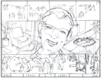
Seniors’ Lessons learned from a life experience
Bill: Another hard time was when I had a breakdown: I got locked up at Mercywood Hospital. That was kinda' rough: When they lock the door behind you and you’re in a hospital that is a hundred years and old surrounded by people in all states of dementia. Those were hard times, but you know, that helped me understand other people. I gained insight into other people through that. That's why I started volunteering for Phoenix High School and Livingston Literacy Council and things like that. Anyway, years later, I ended up becoming the chaplain at Mercywood.
Timeline: http://home.comcast.net/~samiri/director/mentoringNetwork/bill/past.html (bottom of page) ⬅content from older tech arts project
Doris (After the loss of her husband and her son): Well, I said, 'I'm not going to sit around and cry all day.' So I didn't. I looked around to see what I could do. I thought, 'While I am here in this world I'm gonna' be a credit to everybody.' I helped everybody I knew. If they needed a baby sitter, I babysat. I washed. I could cook some, In fact, I could cook good. I helped wherever I could. But that helped me too. It helped me make it.
Chao-xing: As soon as I entered the United States in the late 1960s, I found myself entirely illiterate in English. I could not read, write or speak the language. I had witnessed my parents working from dawn to dusk with limited income. My mother worked at a sewing factory in a basement in Chinatown. That feeling of helplessness was very painful. I was one of six Chinese immigrant women who worked at a wholesale dry cleaner factory as a cluster group to pack military overcoats in shipment boxes bound for overseas. We worked 10 hours a day at $1.99 per hour. At the end of the day, we were exhausted. I often asked myself, besides work as a laborer, what else could I do? To control my own destiny was a powerful motivation for me. I enrolled in a federal training program. At the time, I understood approximately 20% of all class lectures and recognized about 10 to 15% of the vocabulary in my textbooks and homework. I had to look up new words one by one from the dictionary in order to do the homework. It seems my hard work was rewarded, because after two years, I graduated with honors and I was hired as a library assistant in a public library.
Martin: I learned as a kid that even if I really wanted something, enough to spend money on it, if I waited, that desire went away…and if I could control that desire, I’d benefit. Mock Up
Back to Elevator Pitch

Slide 14
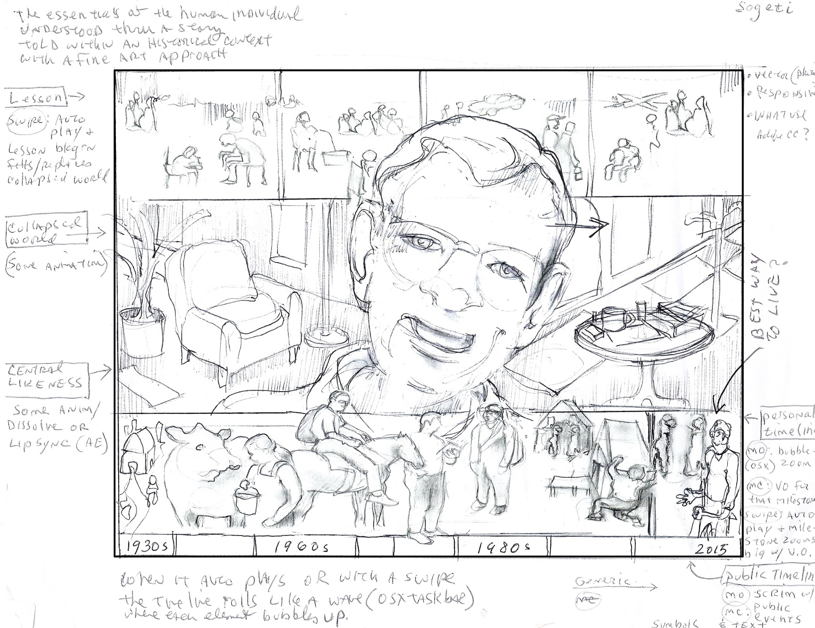
Bill’s Lesson
Back to Elevator Pitch

Slide 15
Examples of Student Writing
Intergenerational Web Project
(content from older tech arts project)
Nik writes regarding Fred, his senior subject: "Fred's childhood is nothing like mine at all. I had it easy- not that my parents were rich, but all I ever did was have fun. Then later I started reading and I guess that had something to do with the way I turned out.
Fred's childhood was almost opposite. I've never done hard farm work. I'm kind of a slacker. I think Fred's farm years formed him into who he is. He didn't get to have much of a childhood like kids today. I think when a person works that hard for so much of their younger years, they don't wind up as opinionated as somebody who spent all their time playing. I guess that's not that much of a bad thing but everyone needs their freedom to be a kid. Hard times make you appreciate the simple things, though."
Chris writes regarding a lesson he learned: "I never used to think about the feelings of my parents and the effects of what I did to them. I never really cared but now I do and I am going to stick with that because I have a terrific relationship with my dad. I was destroying that relationship with my dad and he wasn't trusting me like he used to and he was disappointed with me all the time and we never had as much fun as when he wasn't disappointed.“
Shannon writes regarding a lesson she learned : “At about the age of 13 or 14 I was trying to run my own life and wasn’t listening to my parents’ rules. This went on for a long time so at age 15, I made a choice of not coming home for three days. By that time my parents got fed up with my crap and told me to live somewhere else. So I did. I had fun for a little while but then I started to miss my family and they missed me, too. So six months later I moved home... after I got out of the hospital. It was good. We all got along better. My Mom and I get along real well. I found out that my family is like any other maybe we just handle things differently.”
Back to Elevator Pitch

Slide 16
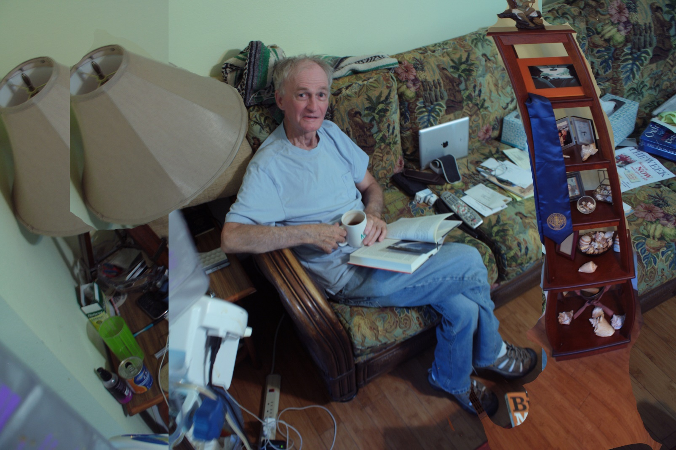
Martin
Audio file (mp3)
Example of Treatment from Pilot
Back to Elevator Pitch

Slide 17
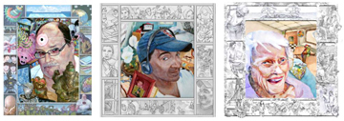
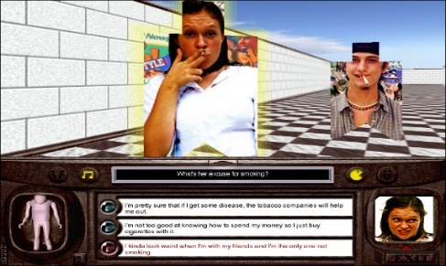
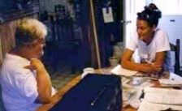
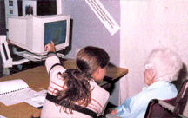
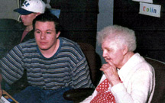
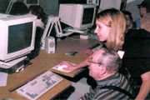
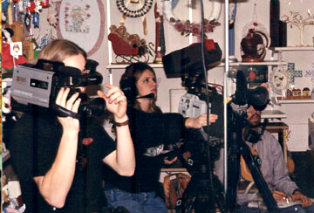
Past Projects
 | Pilot Project: Interactive Web Applications Funder: University of Florida Shands Arts in Medicine Program. Collaborator: Eden Springs This project, involving residents of Eden Springs Nursing Home, resulted in series of collaborative, interactive, life-inventory portraits of senior citizens in which they share their personal histories and lessons learned from life experience.
 | Smoking Prevention Program: Game, Web site and Curriculum. Funders: Blue Cross Blue Shield, Lightwave 3D and others. Collaborators: Wakulla High School Theater Dept., Wakulla Public Library and others. The Cut is a smoking prevention program that includes an interactive 3D, 1st person game, Web site with online games and High School Curriculum. It was designed for Blue Cross Blue Shield to prevent initiation of tobacco use by middle school students through the use of a peer-mentoring approach and the appeal of the 3D gaming.
 | Intergenerational Web Program: Website, Database, Search Engine and Email App. Funders: AOL Foundation, Ann Arbor Community Foundation and others. Collaborators: University of Michigan, Governors' Next Day Program, Ann Arbor Schools and others. This program provided intergenerational and career mentoring opportunities for at-risk high school students in Michigan. The Web site included a searchable database of mentors, Day at Work features, career FAQ pages and a secure mentor-mentee correspondence application. The database was created by over 100 high school students and grew to about 275 web profiles.
 | Intergenerational Video Project Funders: Michigan Council for the Arts, Comcast, Washtenaw Council for the Arts, Collaborators: Ann Arbor Community Television Network, Brighton Area Schools The Mentoring Network involved at-risk teens in the production of a series of broadcasted documentaries about the lives of local senior citizens: their personal histories, successes, struggles and lessons learned from life experiences.
Back to Elevator Pitch

